Slide 1
Public
Final phenotypes algorithms and implementation results: Work that has been tested, validated, implemented, and ready to be shared with the public
Private
Ability to Create phenotype workspaces and collaborate on development, testing, and validation
Levels of Sharing
Only viewable by authors
Only viewable by a Collaborative group or groups
Comment on Phenotypes shared with you
Receive alerts on Phenotypes you are following

Slide 2
Creating a Phenotype
Creating Phenotypes
Data Modalities and Methods – Searchable items so users can find algorithms that meet their needs & capabilities
Age, Gender, Race, Ethnicity – Algorithm demographics
Group – Who you are sharing with, e.g., eMERGE Phenotyping group
Institution – Searchable
Pubmed Reference

Slide 3
Phenotype Status
Phenotype Status
In Development
Only viewable when logged on to the site
Phenotype algorithm and data dictionary are in draft form. Collaboration on the page includes finalizing content of the algorithm and its data elements
Testing
Only viewable when logged on to the site
Phenotype algorithm has been finalize and are now ready to be implemented at select sites. Algorithm has not been finalized and could changes based on how well they do in their implementation
Validated
Only viewable when logged on to the site
Has been tested and validated by persons developing the algorithm and can now be implemented by others
Final
Viewable to the public
Is only sharable privately while authors work to publish their results
Implementation Results are posted and attached to the algorithm
Will have implementation result posted
May only be viewable to the Authors of the Algorithm or a Collaborative group of persons exclusively working on development
May only be viewable to the Authors of the Algorithm or a Collaborative group of persons exclusively working on development
Publication reference should be attached

Slide 4
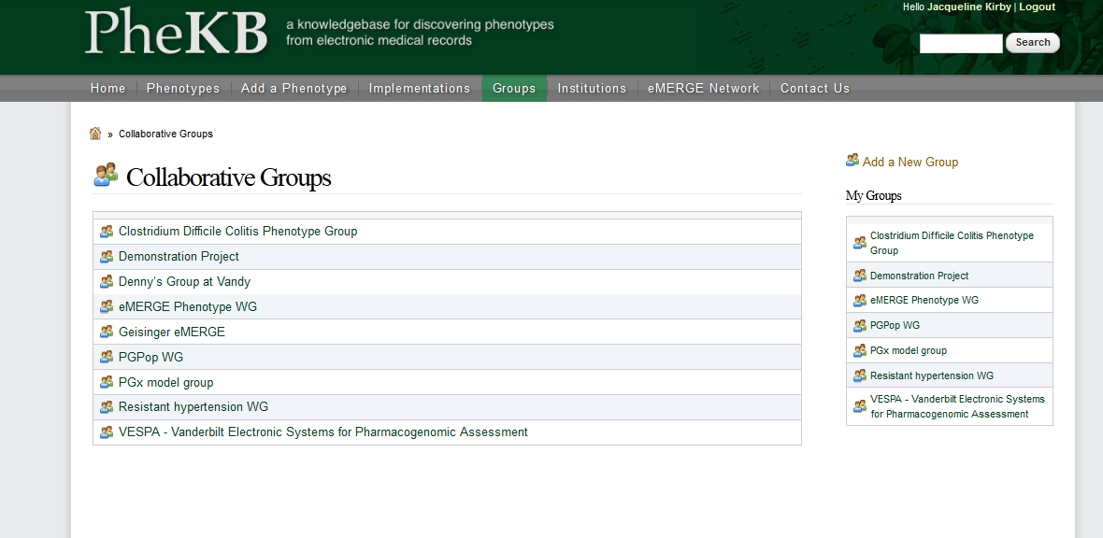
Collaborative Groups: Members of a group
Edit existing phenotypes
Add implementation results to a shared phenotype
Comment on Existing Phenotype
Trigger Alerts to follow activity on a Phenotype

Slide 5
Joining a Collaborative Group
Joining a Collaborative Group
Request to join a group by going to the Collaborative Group page and selecting “Subscribe to group”
You will be prompted to confirm you would like to join the group and be given the option to send a Request Message to the Group Administrator
Until you have been approved by the Group Administrator, you will be unable to view any of the Group’s algorithms
The group administrator approves your membership using the “Group” Tab on the Collaborative Group page
Once you have been approved, the Collaborative Group will appear in the list of groups you are a member.

Slide 6
Finding Phenotypes
Finding Phenotypes
Public Phenotypes are listed
Under the Phenotype tab
On the Group’s Page, if it has been shared with a group
On the Institution’s Page, if it has been designated an Institution
On the Private Side of the site:
On the associated Collaborative Group page
On the home page in the “My Groups’ Drafts” box if a draft phenotype or “My Groups’ Phenotypes” box if it is Final.

